Slide 1
公司介绍
Company Overview
嘉兴嘉嘉汽车零部件制造有限公司
Jiaxing JiaJia Automobile Parts Manufacturing Co.,Ltd.

Slide 2
公司历史及专业方向
Our heritage and expertise
嘉兴嘉嘉汽车零部件制造有限公司是专业减振器&阻尼器的企业。
Jiaxing JiaJia Automobile Parts Manufacturing Company is specialized in production of shock absorber &damper.
公司成立于1995年，已有20余年汽车阻尼器的开发、生产经验。
Formed by Jiaxing government in 1995, became a full private company in 2005, have more than 20 years’
experience on vehicle damper development and manufacturing.
公司现有员工60余名，年销售额￥3000万元，并仍以每年10%左右的速度在快速发展。
60+ staff, ￥30m annual turnover, and 10% year on year growth following.

Slide 3
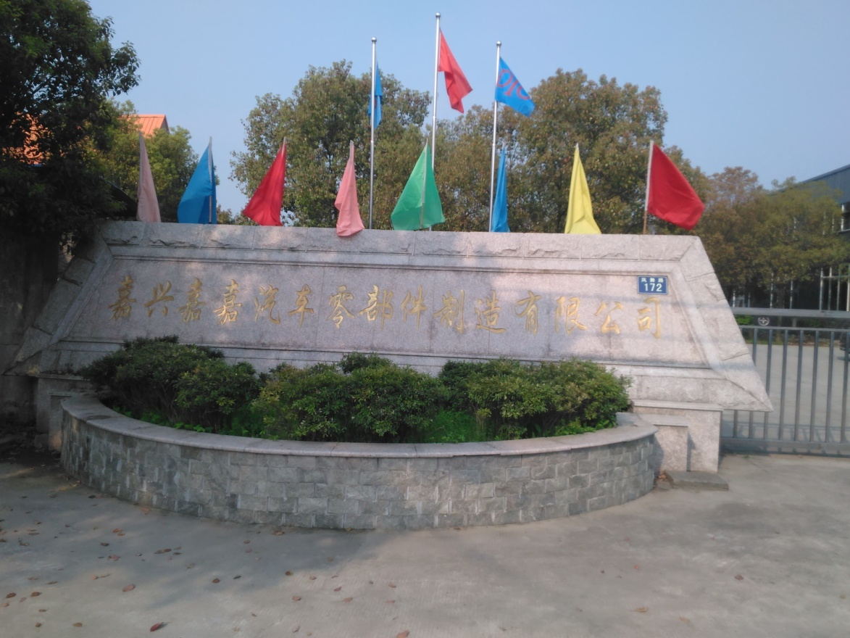
公司历史及专业方向
Our heritage and expertise

Slide 4
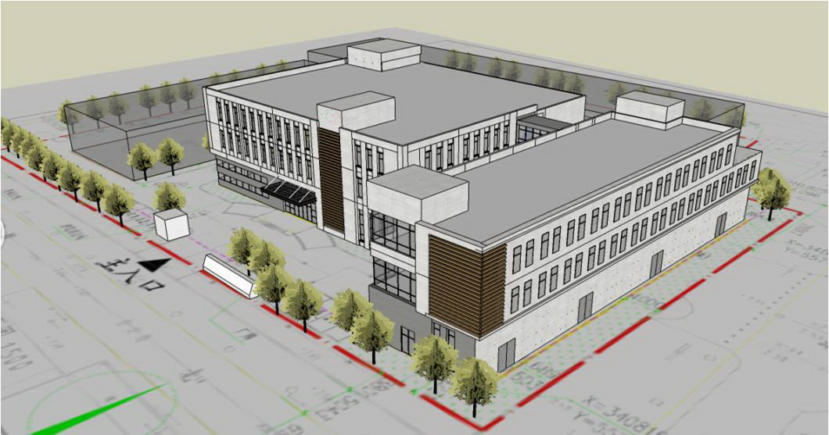
公司历史及专业方向
Our heritage and expertise

Slide 5

企业发展目标及愿景
Company Strategic Goals and Vision
成为中国自主车辆悬架系统供应商，产品设计开发、生产及质量保证能力达到国际一线品牌能力，具备与外资品牌竞争能力。
Become a top level Chinese supplier of vehicle suspension system, developing the capability of product
development, quality and process control as a world-class location, can be competed with international brands.
公司产品在技术能力、质量保证方面定位为具备与国内合资品牌产品进行竞争的能力
Developing technical and quality control capability to compete with international brands.
全力开发国内商用车主机厂配套市场
Develop domestic commercial vehicle OEM market.
进一步开拓海外售后市场
Expanding in key international market
为达成此目标，公司将在未来两年内，进一步加强人才引进、工艺提升及现场改进方面的投入：
To deliver this objective, JiaJia will investment in talent introduction, process improvement and production line
optimization:
引进国内外先进开发及管理团队
Introduce advanced engineering and management team
进一步完善公司产品的试验及试制能力
Build & improve product prototype and test capability
进一步提升现场管理及质量管理能力
Improve process and quality control capability

Slide 6
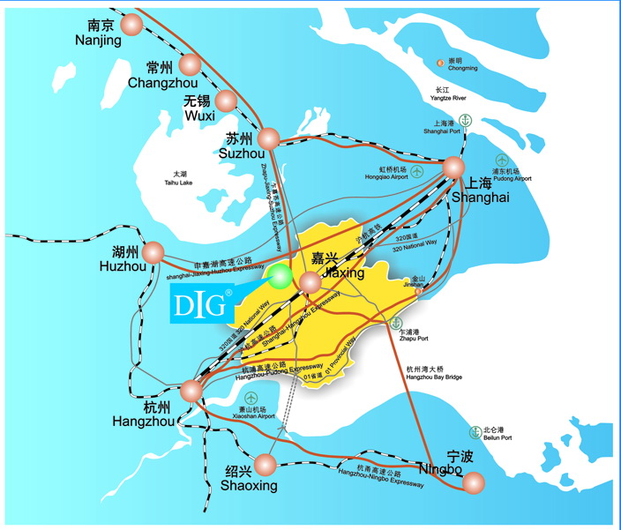
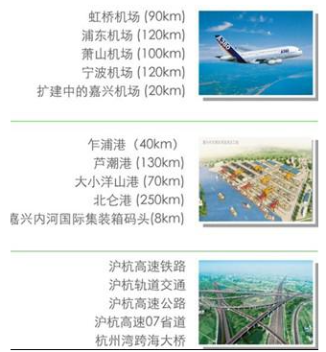
公司所在地及交通
Company Location & Communications

Slide 7
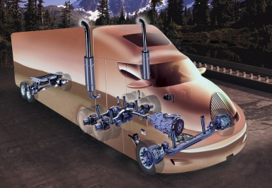
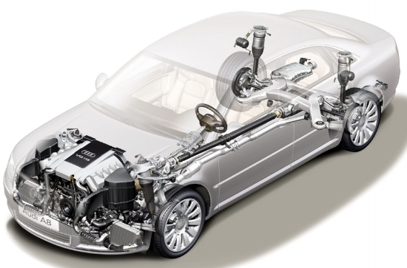
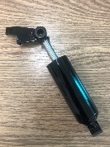
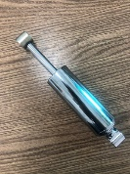
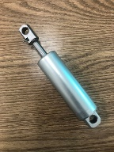
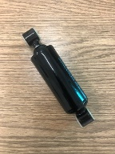
公司业务及现状
Company business & status
全系商用车减振器，涵盖轻、中、重卡及客车底盘减振器，以及重卡驾驶室减振器
Full series of commercial vehicle shock absorber, contain LGV,HGV suspension
damper and also cab damper
具备年产50万支商用车减振器的生产能力 capacity > 500,000/year
ZF SACHS 售后产品指定供应商
Supplier for ZF SACHS after market shock absorber
具备20万支乘用车减振器的生产能力
Capacity > 200,000/year
定阻尼和可调阻尼产品，以汽车座椅以主要市场
Fixed damping force and adjustable damping force， Take car seats to the main market
柔性生产方式，以满足小批量、多品种的需求
Flexible production line, to achieve the demand of small quantity multi varieties

Slide 8
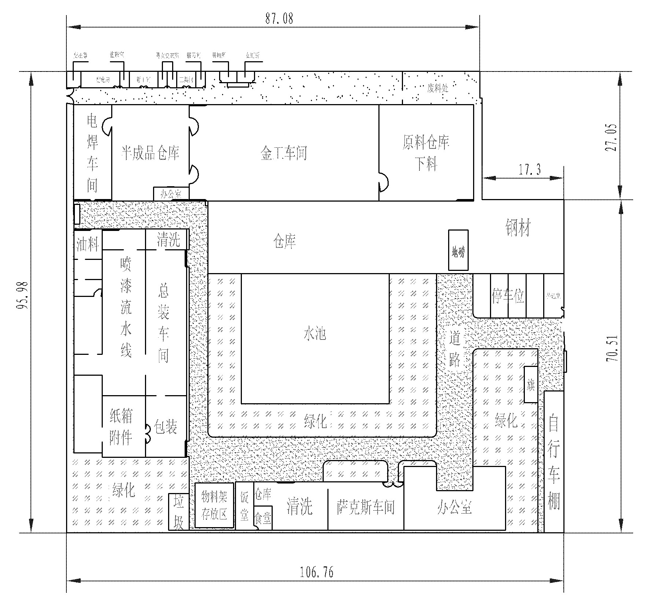
生产场地
Plant layout & profile
公司占地面积10,000平米，其中厂房建筑面积6,500平米
Ground area 10,000㎡, building area 6,500㎡

Slide 9
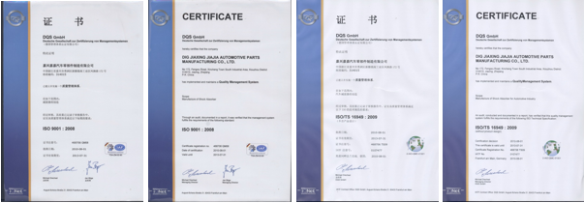
质量体系及客户认可
Quality Certification & Customer Approval
ISO 9001:2008 in Sep. 2002
TS16949:2009 in May. 2007
中国汽车工业协会，减振器委员会会员单位
陕汽军车国庆五十周年阅兵配套产品
德国PE认证供应商
ZF SACHS 指定供应商

Slide 10
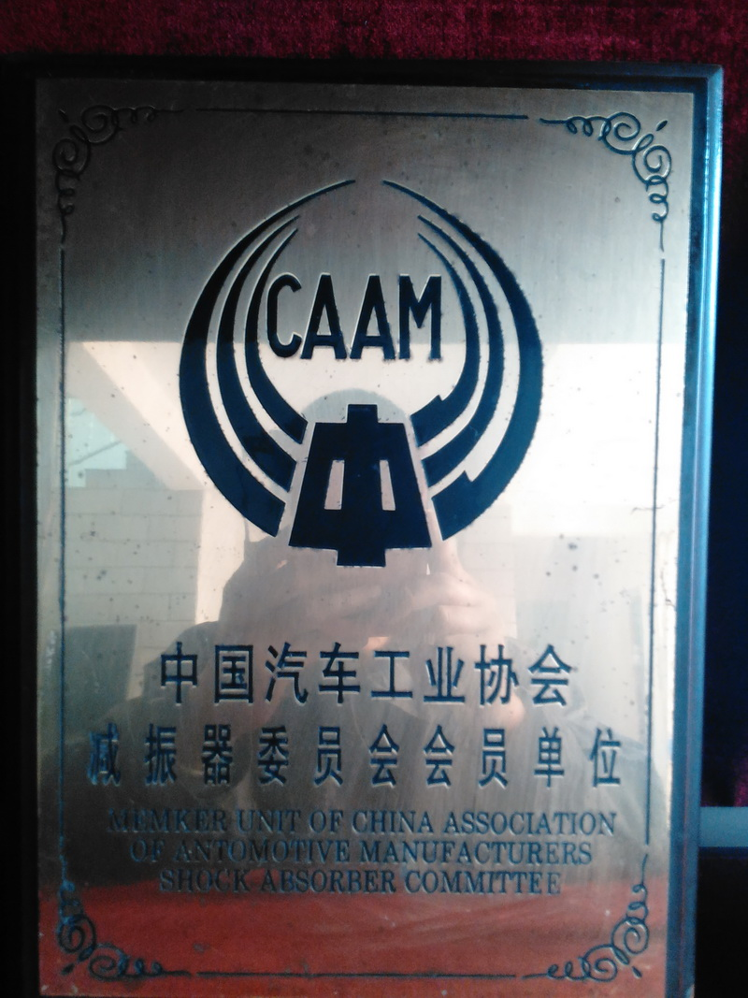
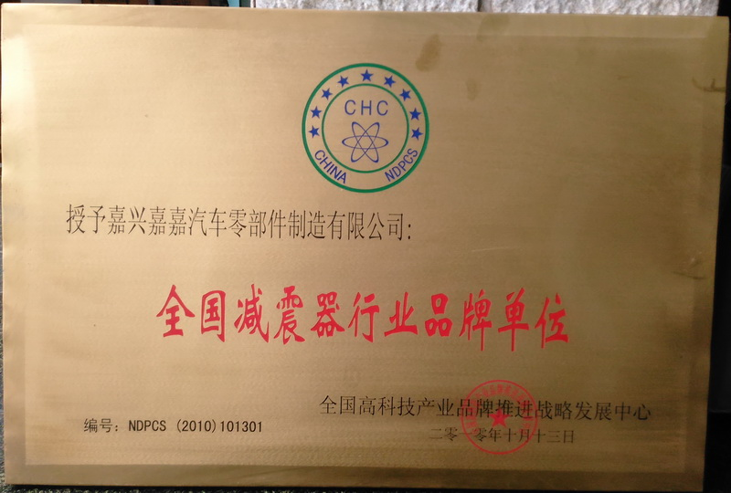
质量体系及客户认可
Quality Certification & Customer Approval

Slide 11
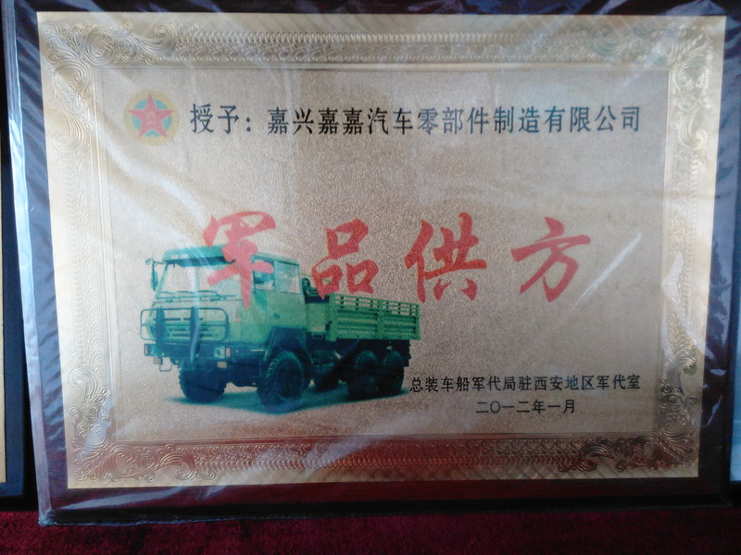
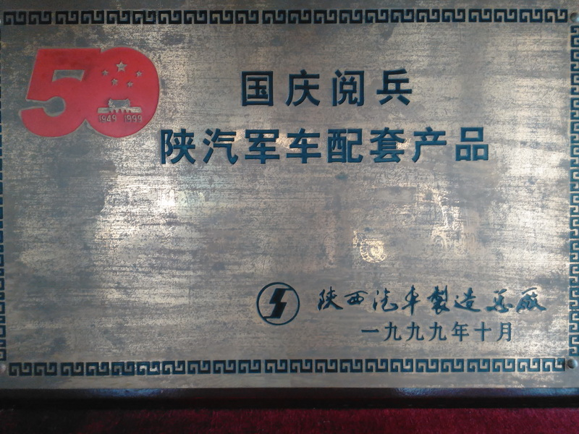
质量体系及客户认可
Quality Certification & Customer Approval

Slide 12
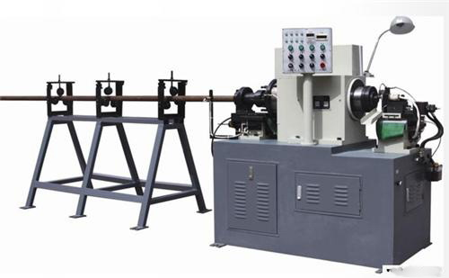
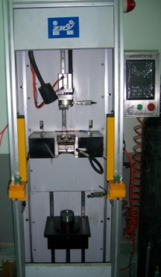
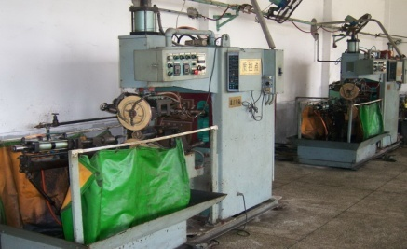
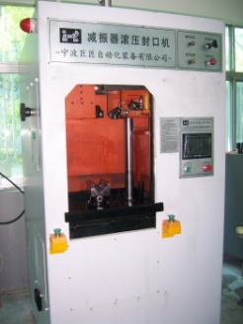
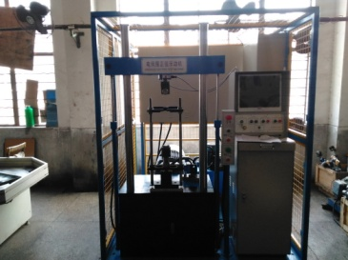
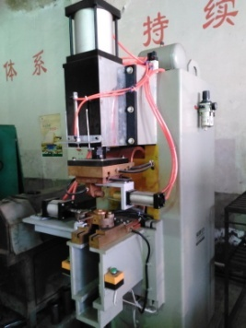
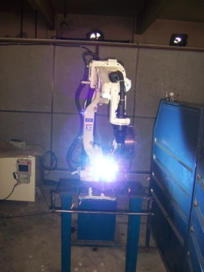
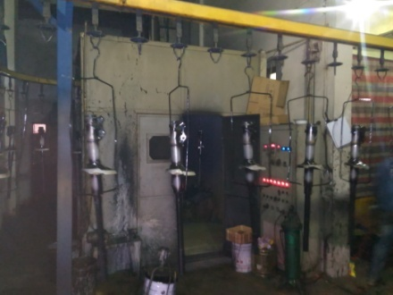
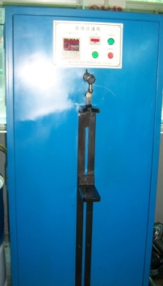
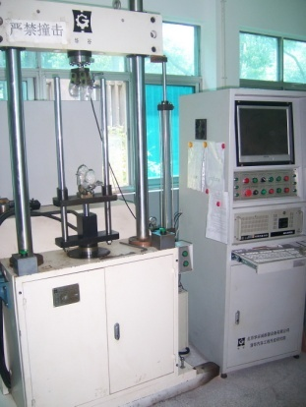
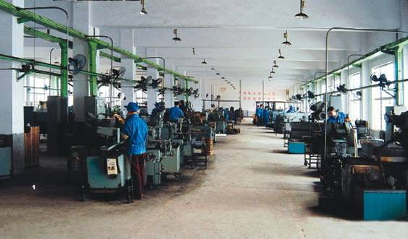
产品开发能力 – 关键生产及测试设备
Product Development Capability – key product and test facilities
图片
缸筒及活塞杆加工
阀片及活塞检测
贮油筒焊接
涂装
总成装配
总成检测

Slide 13






产品开发能力 – 核心团队及合作伙伴
Product Development Capability – Core engineering team & Partner
Engineering Partners

Slide 14
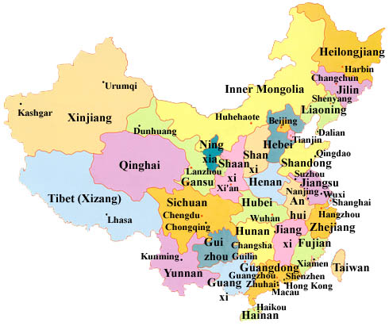









主要客户
Key customers
PE
SAMARO

Slide 15
The End
Thank you for your time
Welcome to JiaJia
地址: 浙江省嘉兴市，新塍镇凤舞 路172号
邮编: 314015
电话: 0573-83411876
传真: 0573-83411871
邮箱: web@cn-absorber.com
Address: No:172 Fengwu Road ,XingCheng , JiaXing, ZheJiang, PRC
Zip Code: 314015
Tel.-No.: 0086-573-83411876
Fax.-No.: 0086-573-83411871
E--Mail: wu-jzh@163.com

