Slide 1
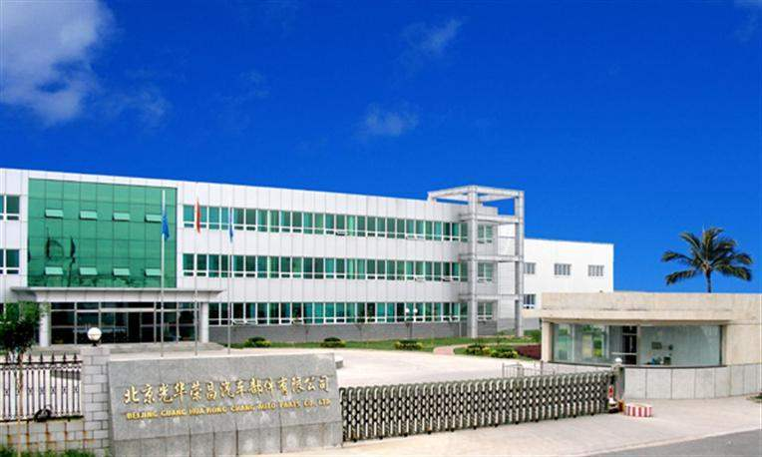
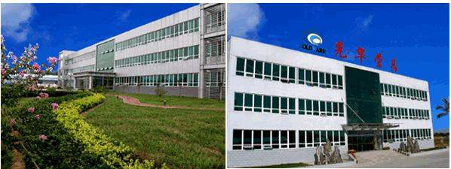
沃尔沃皮纹指示书

Slide 2
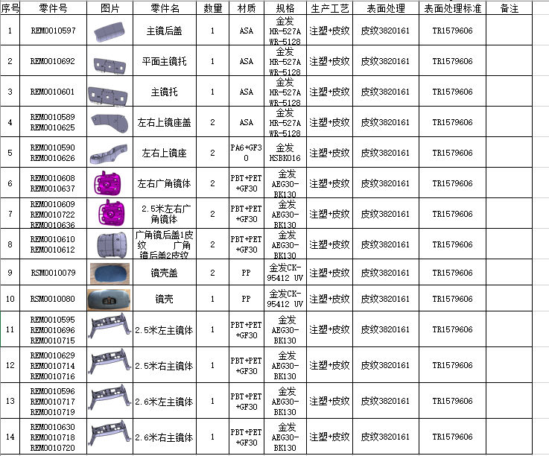

Slide 3
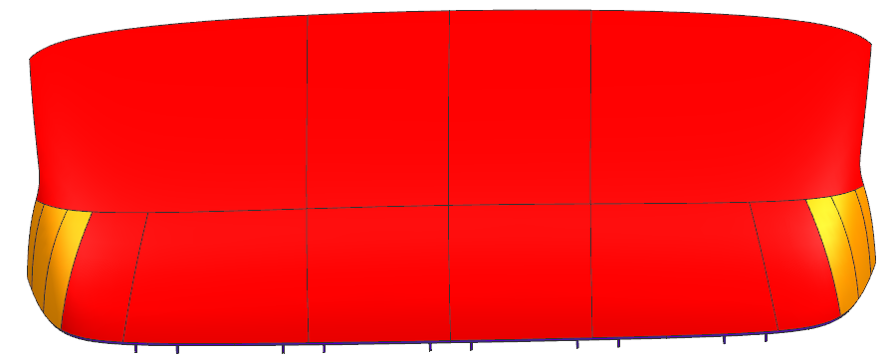
Part No. | Part name | ZGS | Decoration
REM001059 | 主镜后盖 | 001 | TR1579606
Grain type:382161
Dec ： TR 1579606
Gloss:
TR1579606 100%
TR1579606 80%

Slide 4
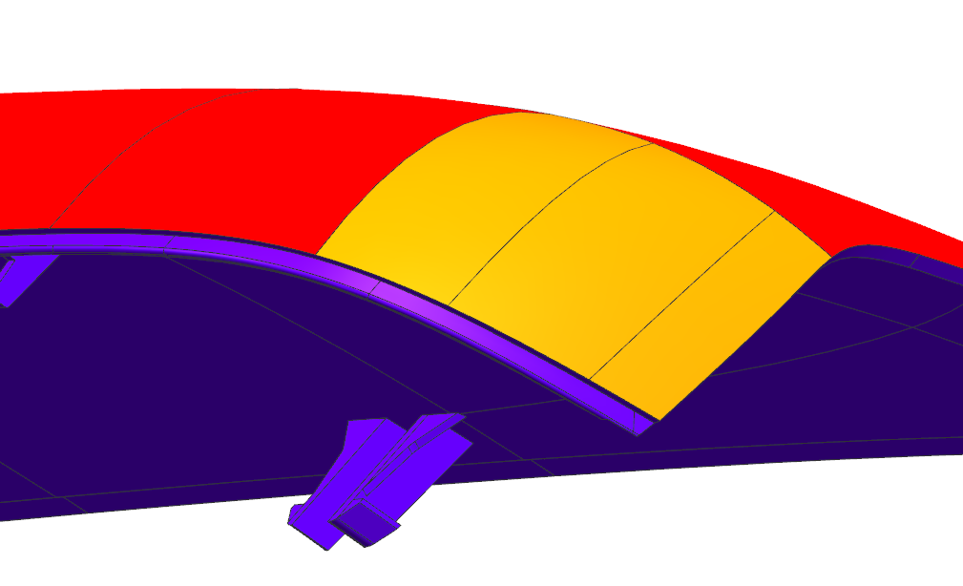

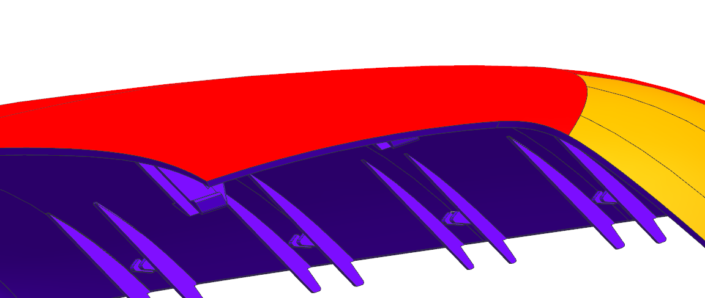
Part No. | Part name | ZGS | Decoration
REM0010597 | 主镜后盖 | 001 | TR1579606
Grain type:382161
Dec ： TR 1579606
Gloss:

Slide 5
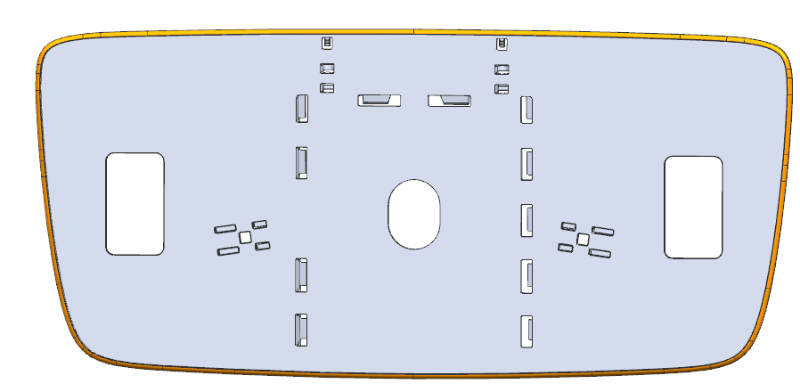
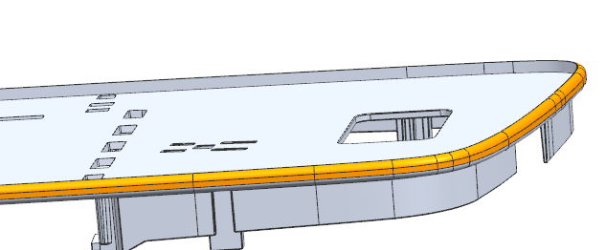
Part No. | Part name | ZGS | Decoration
REM0010692 | 平面主镜托 | 001 | TR1579606
Grain type:382161
Dec ： TR 1579606
Gloss:
TR1579606 50%

Slide 6
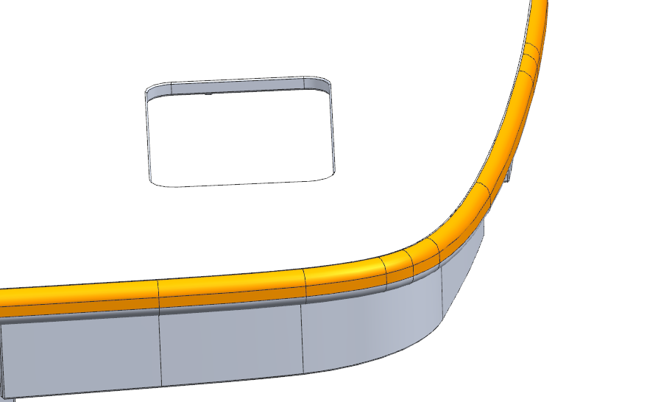

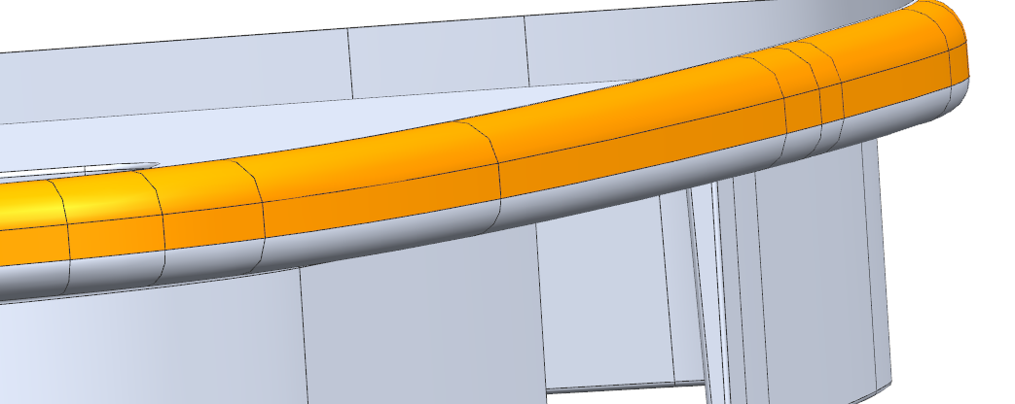
Part No. | Part name | ZGS | Decoration
REM0010692 | 平面主镜托 | 001 | TR1579606
皮纹到此线停止（不包含圆角） The texture stops at this line (not including the rounded corner)

Slide 7
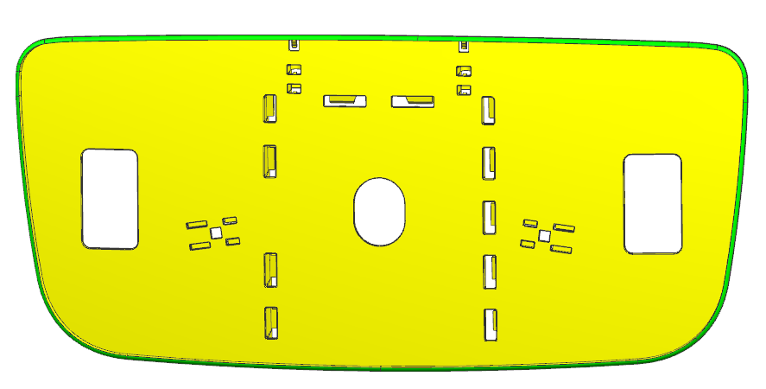
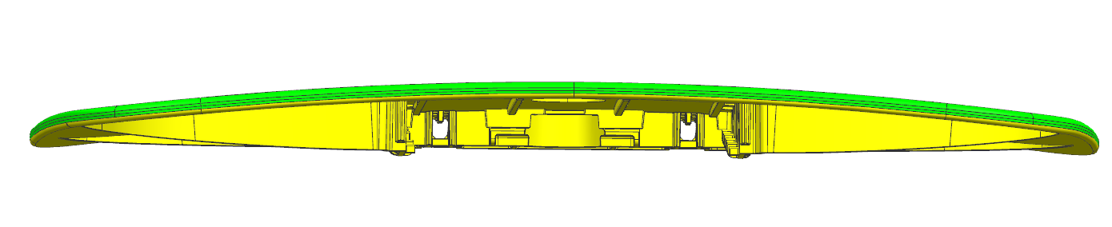
Part No. | Part name | ZGS | Decoration
REM0010601 | 主镜托 | 001 | TR1579606
Grain type:382161
Dec ： TR 1579606
Gloss:
TR1579606 50%

Slide 8
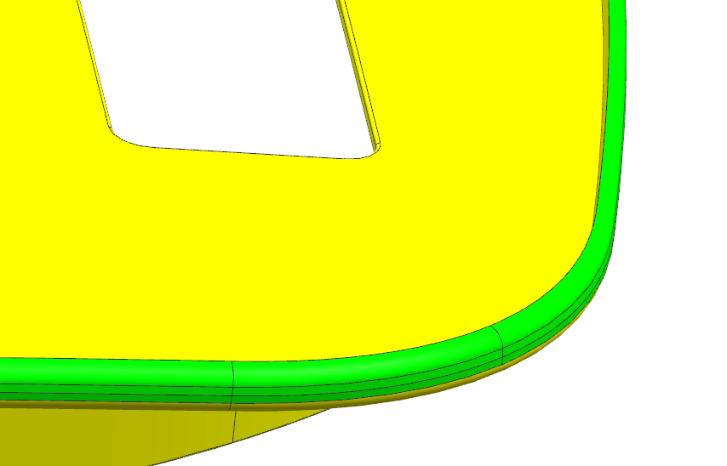
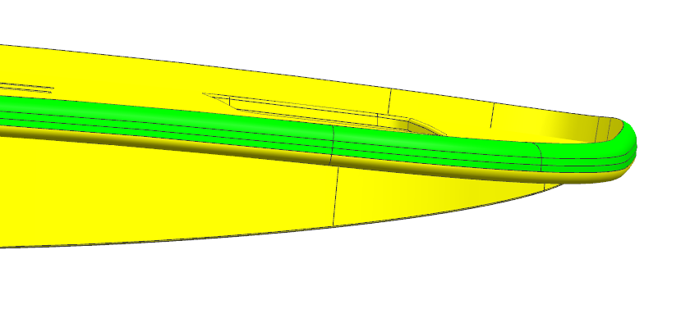
Part No. | Part name | ZGS | Decoration
REM0010601 | 主镜托 | 001 | TR1579606
皮纹到此线停止（不包含圆角） The texture stops at this line (not including the rounded corner)

Slide 9
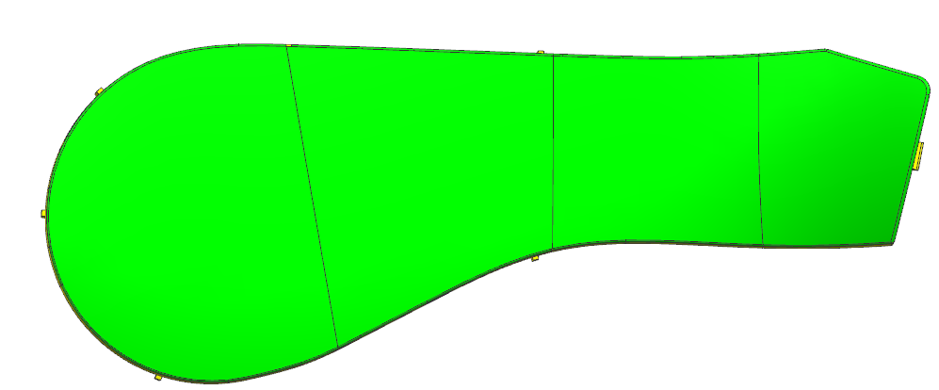
Part No. | Part name | ZGS | Decoration
REM0010589 REM0010625 | 左右上镜座盖 | 001 | TR1579606
Grain type:382161
Dec ： TR 1579606
Gloss:
TR1579606 100%

Slide 10
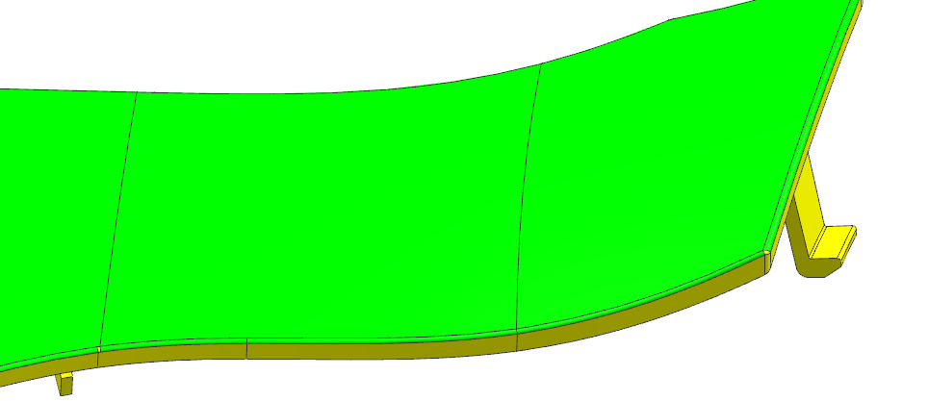
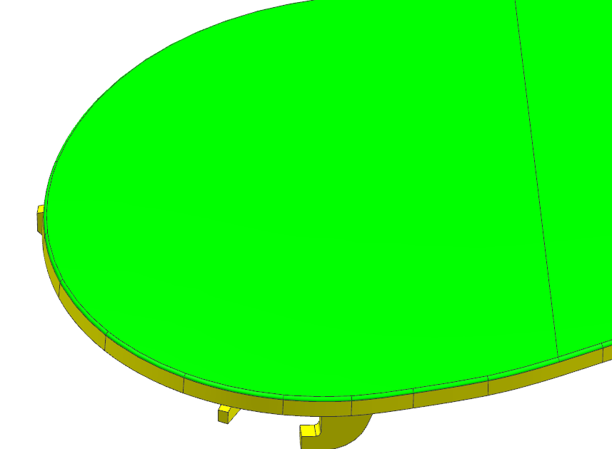
Part No. | Part name | ZGS | Decoration
REM0010589 REM0010625 | 左右上镜座盖 | 001 | TR1579606

Slide 11
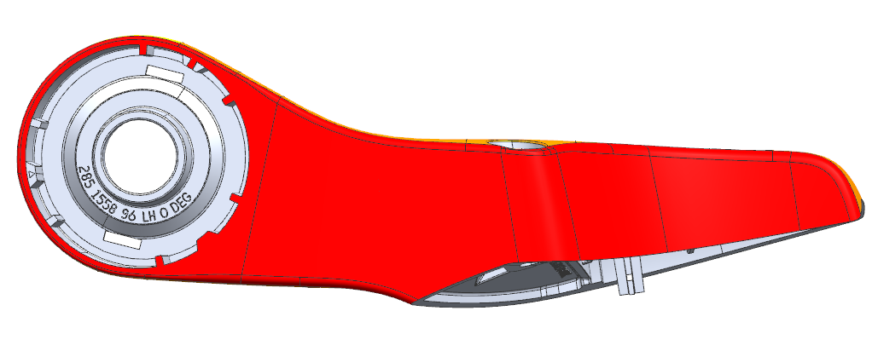
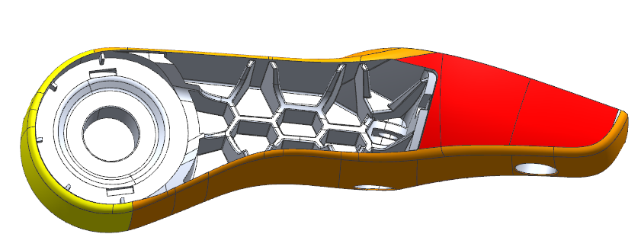
Part No. | Part name | ZGS | Decoration
REM0010590 REM0010626 | 左右上镜座 | 001 | TR1579606
Grain type:382161
Dec ： TR 1579606
Gloss:
TR1579606 100%

Slide 12
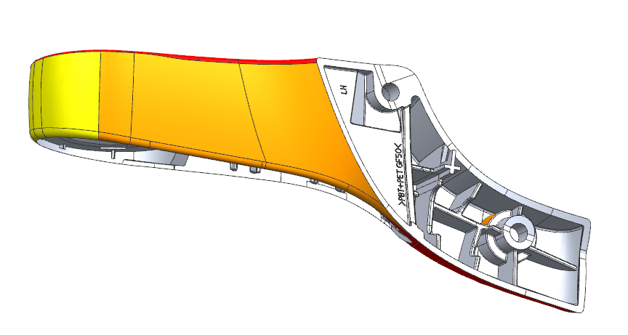
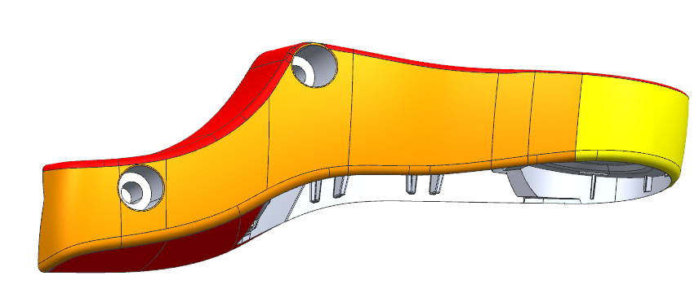
Part No. | Part name | ZGS | Decoration
REM0010590 REM0010626 | 左右上镜座 | 001 | TR1579606
Grain type:382161
Dec ： TR 1579606
Gloss:
TR1579606 75%

Slide 13
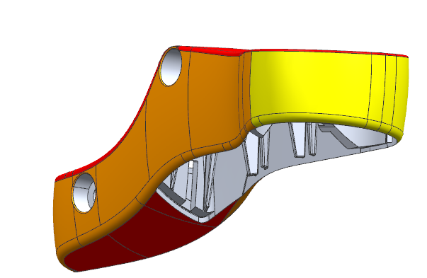
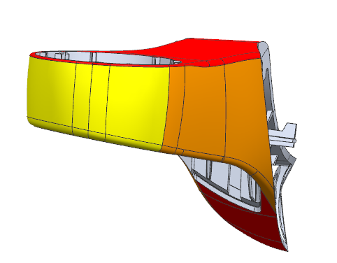
Part No. | Part name | ZGS | Decoration
REM0010590 REM0010626 | 左右上镜座 | 001 | TR1579606
Grain type:382161
Dec ： TR 1579606
Gloss:
TR1579606 50%

Slide 14
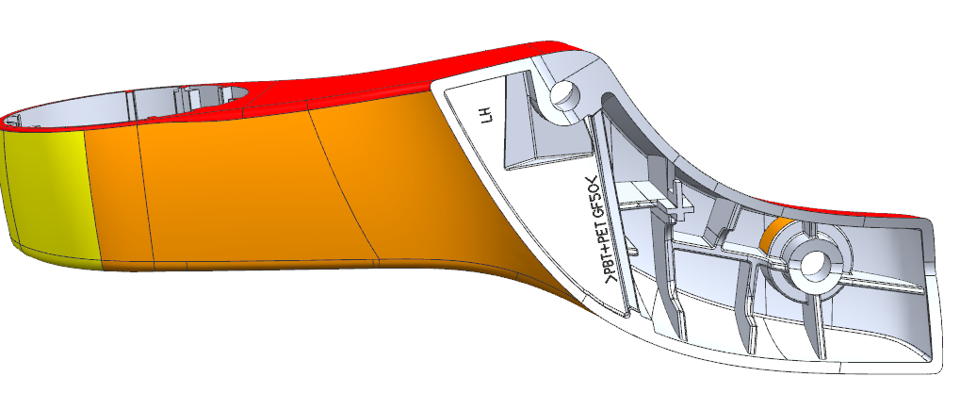
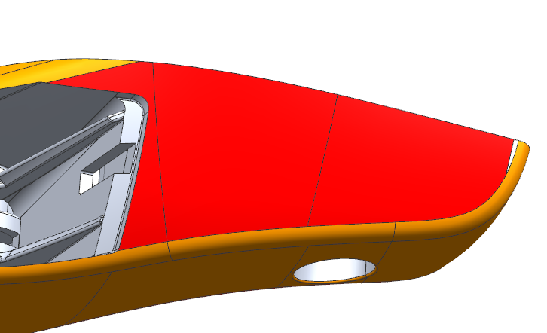
Part No. | Part name | ZGS | Decoration
REM0010590 REM0010626 | 左右上镜座 | 001 | TR1579606

Slide 15
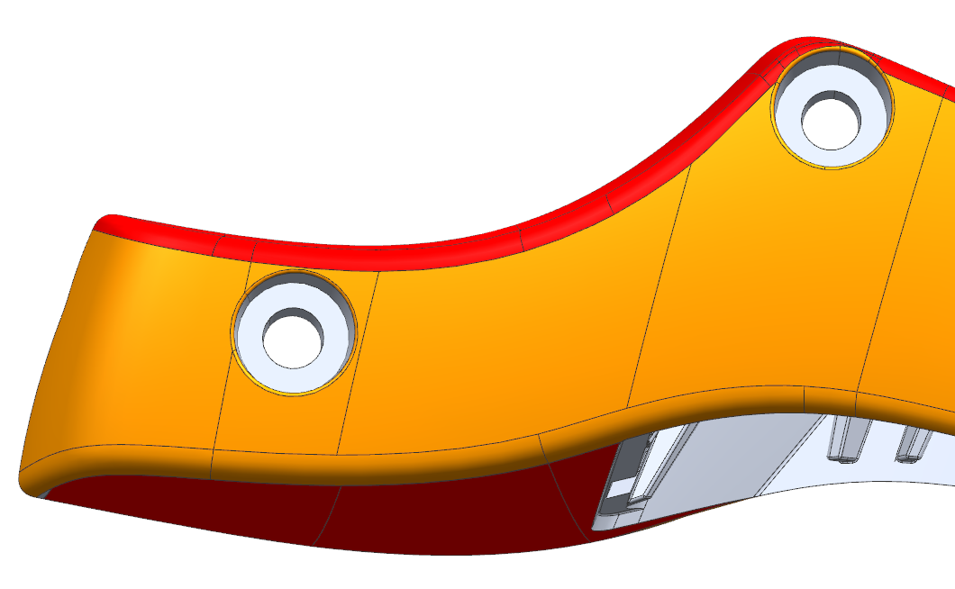
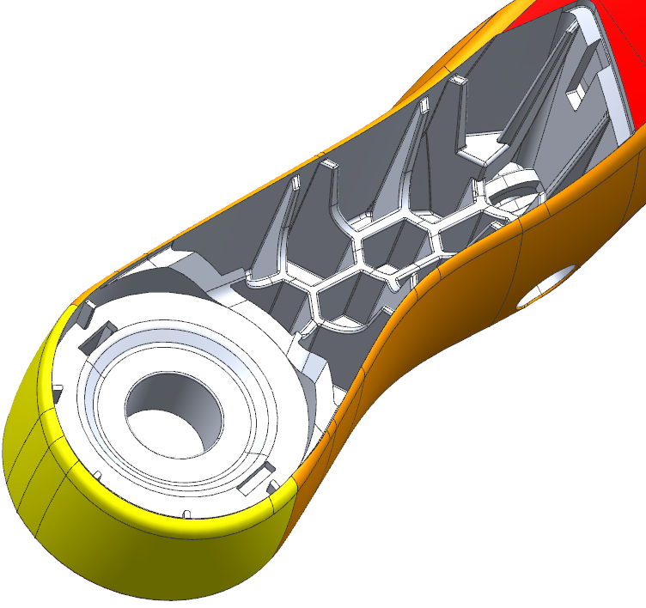
Part No. | Part name | ZGS | Decoration
REM0010590 REM0010626 | 左右上镜座 | 001 | TR1579606

Slide 16
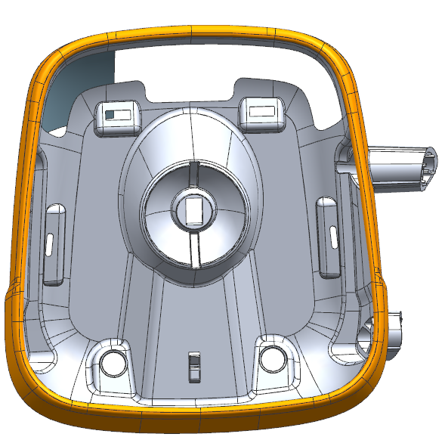
Part No. | Part name | ZGS | Decoration
REM0010608 REM0010637 | 左右广角镜体 | 001 | TR1579606
Grain type:382161
Dec ： TR 1579606
Gloss:
TR1579606 100%

Slide 17
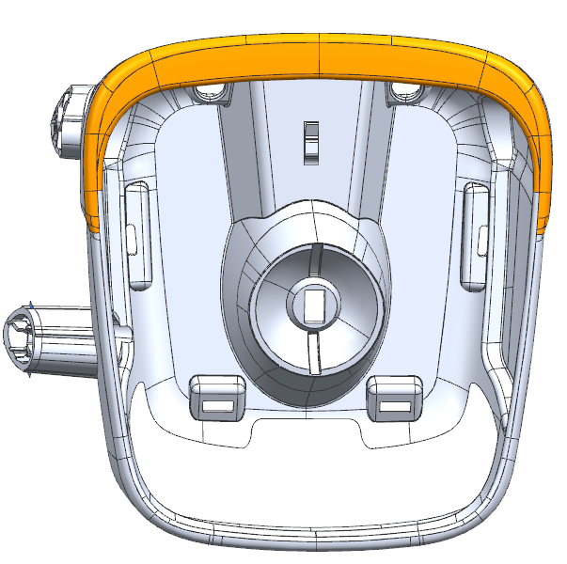
Part No. | Part name | ZGS | Decoration
REM0010609 REM0010722 REM0010636 REM0010721 | 2.5米左右广角镜体 | 001 | TR1579606
Grain type:382161
Dec ： TR 1579606
Gloss:
TR1579606 100%

Slide 18
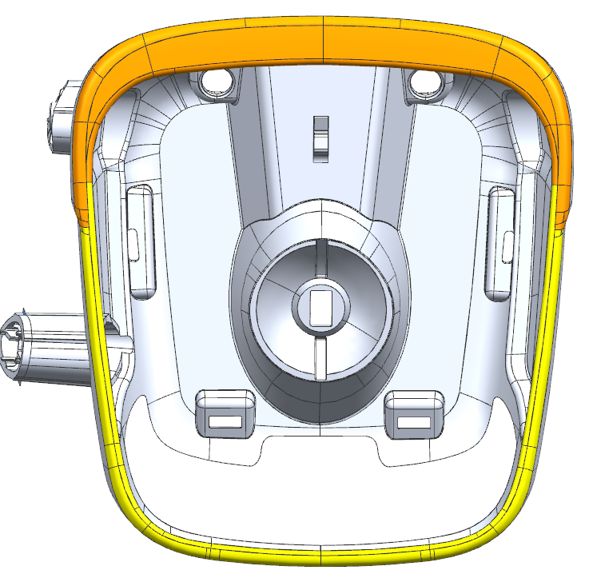
Part No. | Part name | ZGS | Decoration
REM0010609 REM0010722 REM0010636 REM0010721 | 2.5米左右广角镜体 | 001 | TR1579606
Grain type:382161
Dec ： TR 1579606
Gloss:
TR1579606 75%

Slide 19
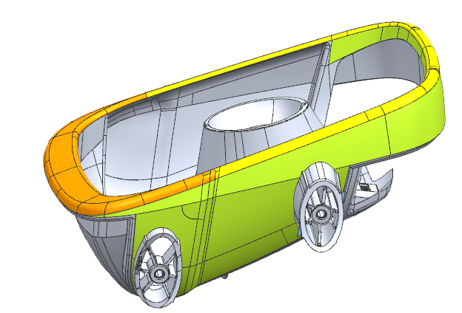
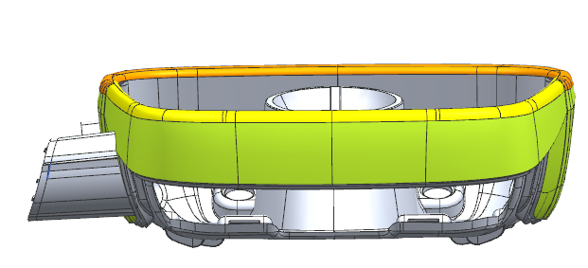
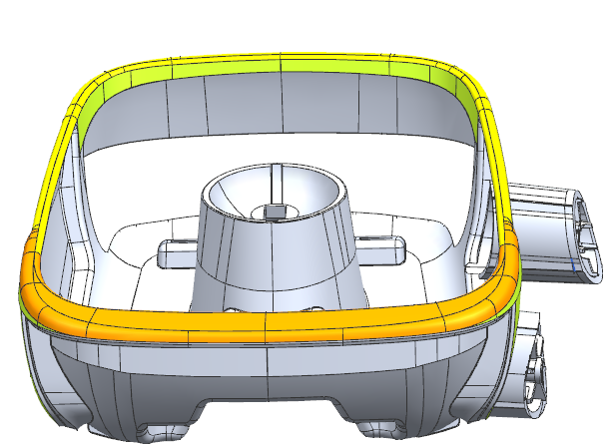
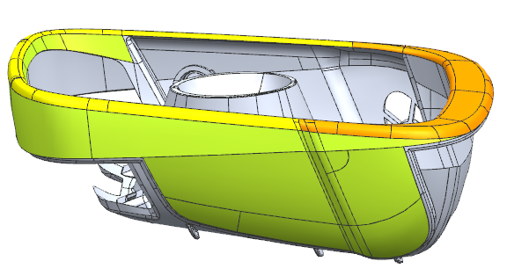
Part No. | Part name | ZGS | Decoration
REM0010609 REM0010722 REM0010636 REM0010721 | 2.5米左右广角镜体 | 001 | TR1579606
Grain type:382161
Dec ： TR 1579606
Gloss:
TR1579606 50%

Slide 20
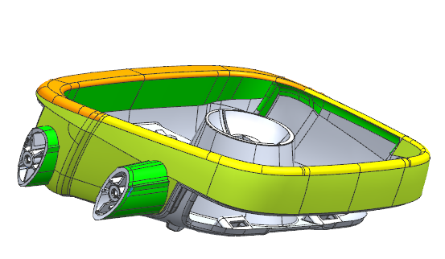
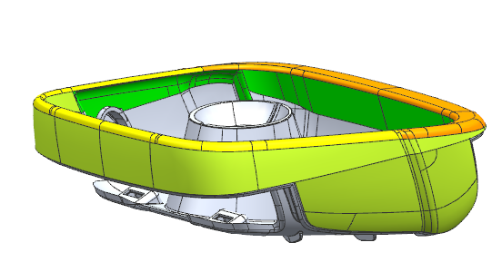
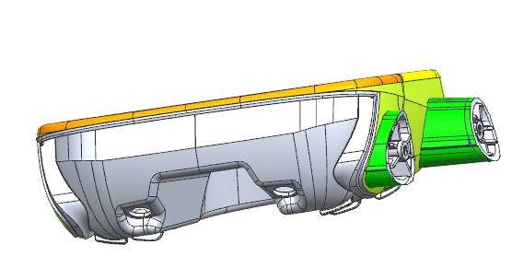
Part No. | Part name | ZGS | Decoration
REM0010609 REM0010722 REM0010636 REM0010721 | 2.5米左右广角镜体 | 001 | TR1579606
Grain type:382161
Dec ： TR 1579606
Gloss:
TR1579606 30%

Slide 21
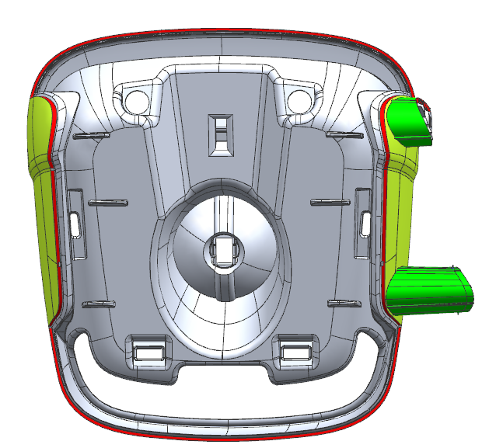
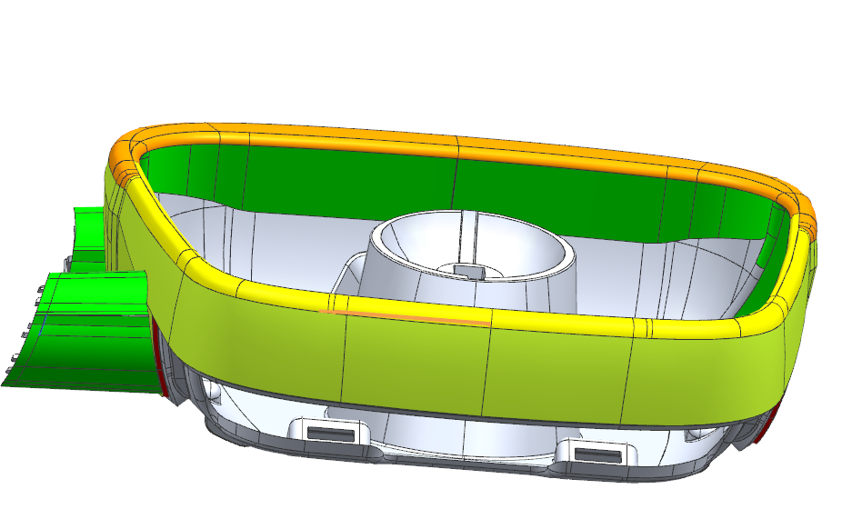
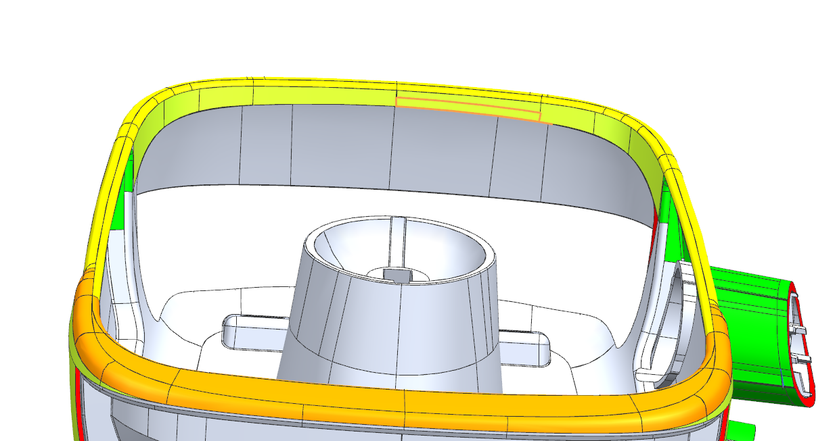
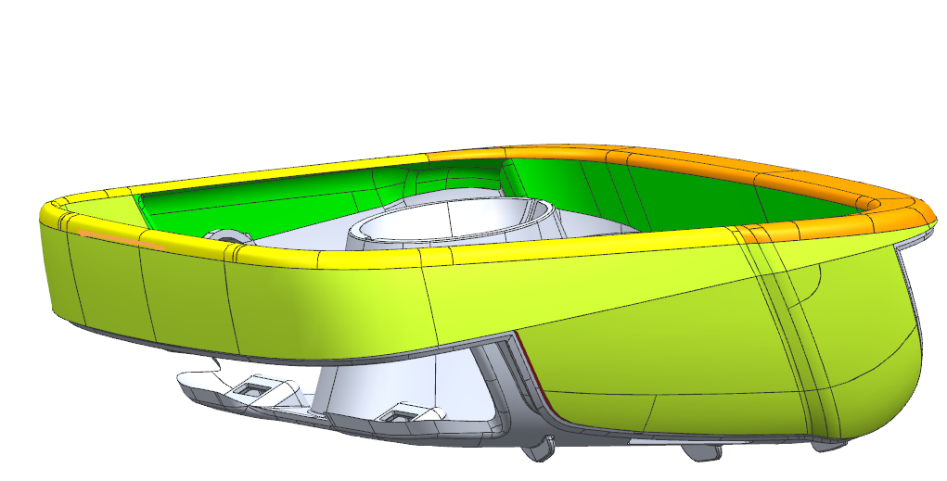
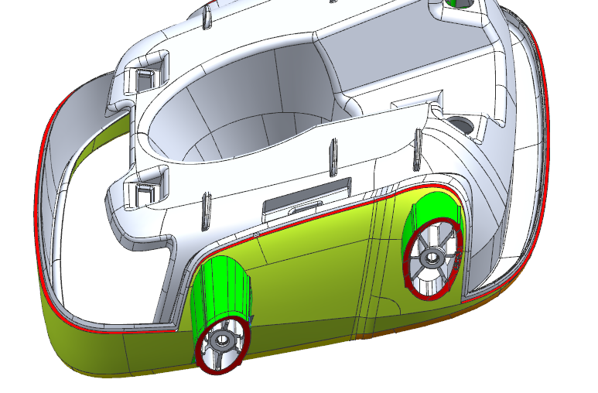
Part No. | Part name | ZGS | Decoration
REM0010609 REM0010722 REM0010636 REM0010721 | 2.5米左右广角镜体 | 001 | TR1579606

Slide 22

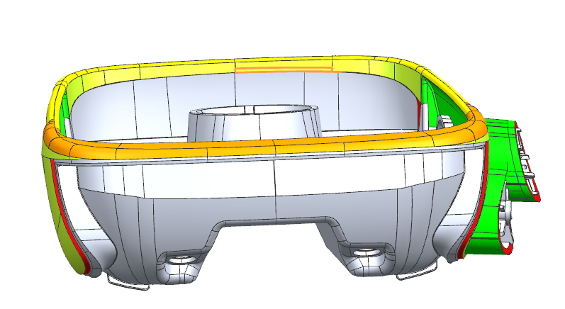
Part No. | Part name | ZGS | Decoration
REM0010609 REM0010722 REM0010636 REM0010721 | 2.5米左右广角镜体 | 001 | TR1579606

Slide 23
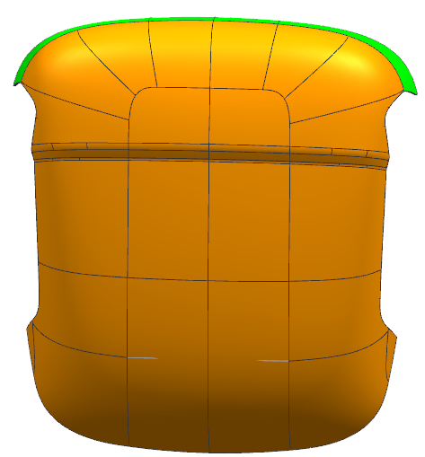
Part No. | Part name | ZGS | Decoration
REM0010610 REM0010612 | 广角镜后盖1皮纹 广角镜后盖2皮纹 (拐角相对圆滑) | 001 | TR1579606
Grain type:382161
Dec ： TR 1579606
Gloss:
TR1579606 100%
TR1579606 100%

Slide 24
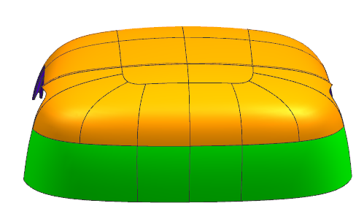
Part No. | Part name | ZGS | Decoration
REM0010610 REM0010612 | 广角镜后盖1皮纹 广角镜后盖2皮纹 (拐角相对圆滑) | 001 | TR1579606
Grain type:382161
Dec ： TR 1579606
Gloss:
TR1579606 75%

Slide 25
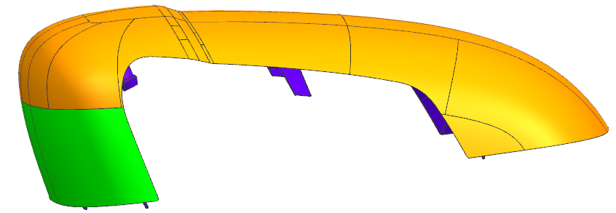
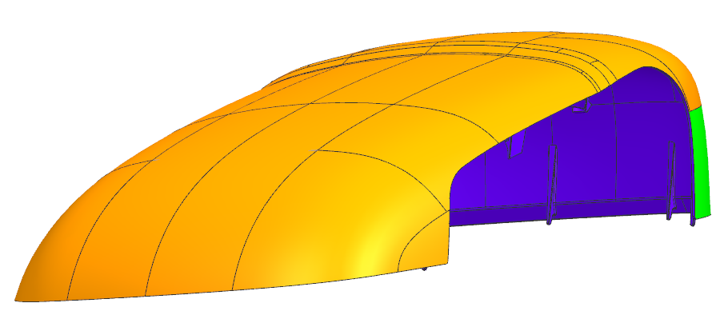
Part No. | Part name | ZGS | Decoration
REM0010610 REM0010612 | 广角镜后盖1皮纹 广角镜后盖2皮纹 (拐角相对圆滑) | 001 | TR1579606

Slide 26
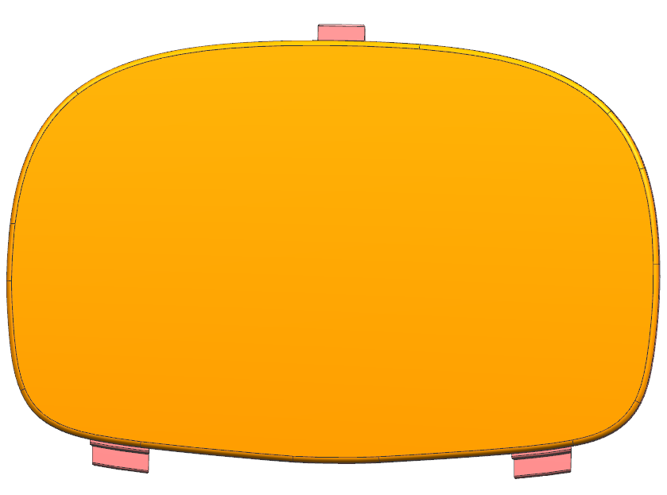
Part No. | Part name | ZGS | Decoration
RSM0010079 | 镜壳盖 | 001 | TR1579606
Grain type:382161
Dec ： TR 1579606
Gloss:
TR1579606 100%

Slide 27
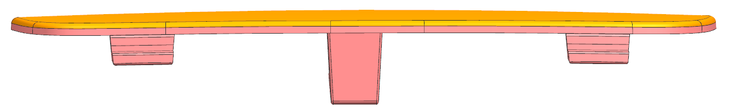

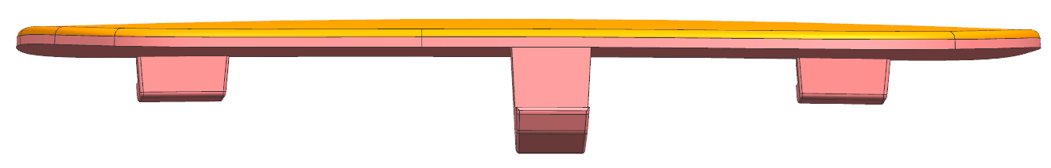
Part No. | Part name | ZGS | Decoration
RSM0010079 | 镜壳盖 | 001 | TR1579606

Slide 28


Part No. | Part name | ZGS | Decoration
RSM0010080 | 镜壳 | 001 | TR1579606
Grain type:382161
Dec ： TR 1579606
Gloss:
TR1579606 100%

Slide 29


Part No. | Part name | ZGS | Decoration
RSM0010080 | 镜壳 | 001 | TR1579606
Grain type:382161
Dec ： TR 1579606
Gloss:
TR1579606 50%

Slide 30


Part No. | Part name | ZGS | Decoration
RSM0010080 | 镜壳 | 001 | TR1579606

Slide 31


Part No. | Part name | ZGS | Decoration
REM0010595 REM0010696 REM0010715 | 2.5米左主镜体 | 001 | TR1579606
Grain type:382161
Dec ： TR 1579606
Gloss:
TR1579606 100%

Slide 32



Part No. | Part name | ZGS | Decoration
REM0010595 REM0010696 REM0010715 | 2.5米左主镜体 | 001 | TR1579606
Grain type:382161
Dec ： TR 1579606
Gloss:
TR1579606 75%

Slide 33


Part No. | Part name | ZGS | Decoration
REM0010595 REM0010696 REM0010715 | 2.5米左主镜体 | 001 | TR1579606

Slide 34

Part No. | Part name | ZGS | Decoration
REM0010595 REM0010696 REM0010715 | 2.5米左主镜体 | 001 | TR1579606

Slide 35

Part No. | Part name | ZGS | Decoration
REM0010595 REM0010696 REM0010715 | 2.5米左主镜体 | 001 | TR1579606

